Slide 1
TITLE HOSTEL HUNT

Slide 2
Area Of Application
Student Accommodation
Professional Accommodation
Accommodation Providers
Educational Institutes

Slide 3
Need Of the System
The need for the system arises for finding suitable accommodation for students and professionals.
Centralized Platform:-Currently, individuals seeking PGs or hostels have to rely on scattered information from various sources , leading to a lack of transparency and inconvenience in the selection process.
Standardized Information:-facilities, room availability, pricing, and amenities)
Market Visibility for Providers:- Many local PGs and hostels may struggle with visibility and marketing.
Safety and Security: Ensuring the safety and security of accommodations is a crucial concern for both occupants and providers.

Slide 4
Business Use Cases
User Registration:
User: Potential occupants, Accommodation providers
This use case involves the process of users registering on the PG-Hostel Explorer platform.
Accommodation Search:
User : Potential occupants
This use case allows potential occupants to search for PGs and hostels based on their preferences, budget constraints, and safety considerations.
Booking and Reservation:
User: Potential occupants
This use case involves the process of potential occupants booking and reserving accommodations through the platform.
Profile Management:
User: Accommodation providers
This use case allows accommodation providers to manage and update their profiles on the platform, showcasing details about facilities, room availability, pricing, and amenities.

Slide 5
Users And Use Cases
Users
Admin
User Authorization
Transaction Monitoring
System Oversight
Occupants
User Registration
Accommodation Search
Booking
Provider
Registration
Profile Management
Occupancy Status

Slide 6
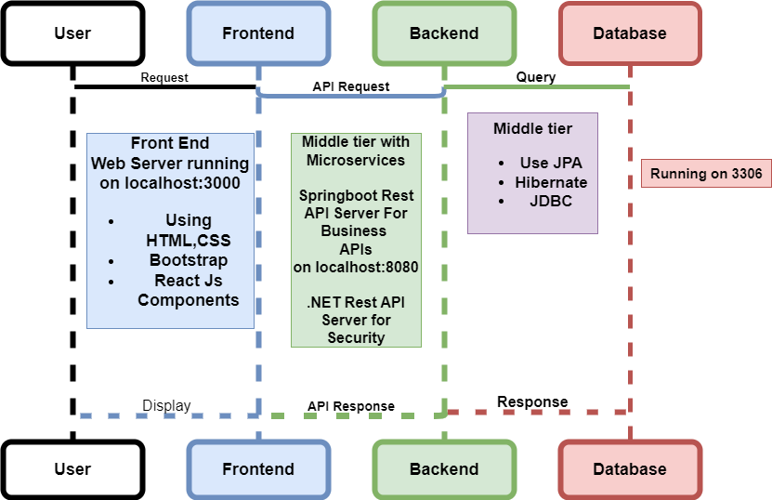
Project Architecture

Slide 7
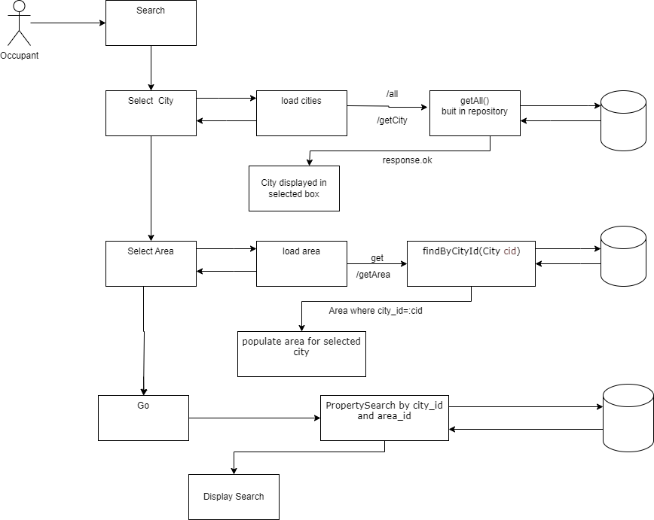
Workflow Diagram

Slide 8
Project Methodology
Details Of Phase 1
Entities are created.
Database Created.
Use Case Diagram.
Work Flow Diagram Created.
React Js Components Created.
Login and registration.
Details of Phase 2
Functionalities Tested and Implemented.
Search Property.
Select area and city from database using React and accordingly fetch properties.
CRUD Operations.
Details Of Phase 3
Add Facility by owner for particular property.
Show facilities to occupant for a particular property.
Booking Request sent by occupant Tested.
Approval by owner tested.
Booking by occupant is done.

Slide 9
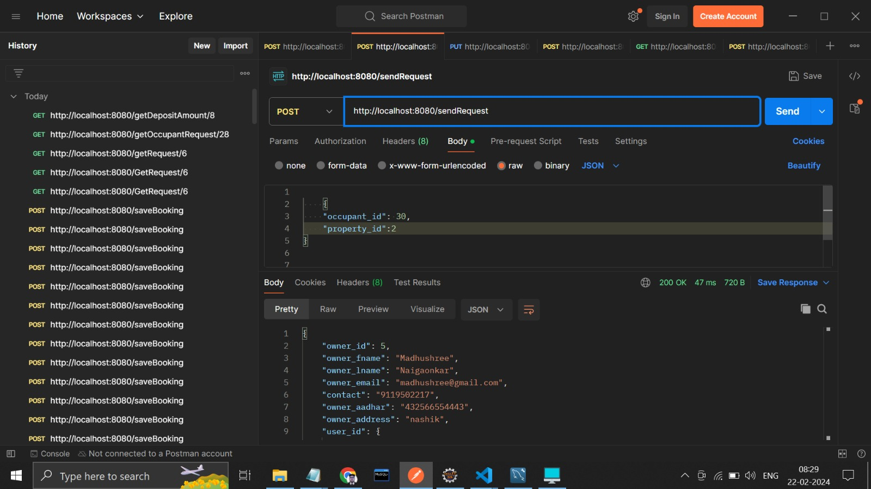
Testing Approach
Testing Done at Different tiers
Database testing done using dumping values.
REST API using Postman.

Slide 10
Future Extension
Geographic Expansion:
Initially targeting a specific city in phase 1, the platform can gradually expand its coverage to include additional cities and regions.
Educational Institute:
The system fetches property according to area and city in next phase we can fetch the hostels near to educational institutes.

